Slide 1
Dimensionality Reduction
Advanced Machine Learning
Data Science at Zindua School | By Chris Aloo

Slide 2
Topic Coverage
Week 1 Dimensionality Reduction : PCA, TSNE
Week 2 Clustering : Kmeans, Hierachical, Density Clustering, GMM
Week 3 TimeSeries : TSA and Time Series Models
Week 4 Deep Learning Foundations : MLP, CNN, RNN, GAN, Autoencoders
Week 5 End of Module Project

Slide 3

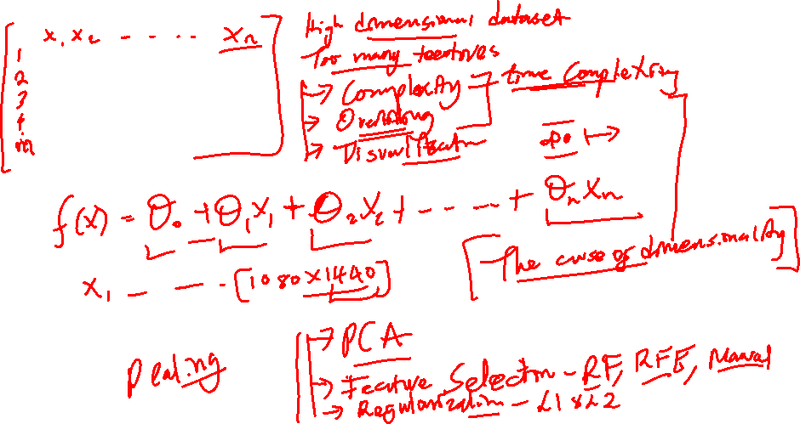

Slide 4
Different techniques for Dimensionality Reduction
  PCA
  Feature Selection : Random Forest Feature Importance, RFE, Manual Feature Selection
  Regularization : L1 - Lasso and L2 – Ridge – Which one is most effective in feature selection – Lasso is able to shrink the parameter close to zero.

Slide 5
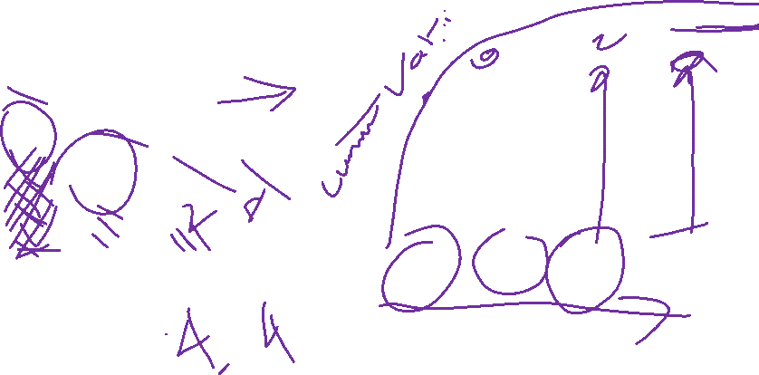
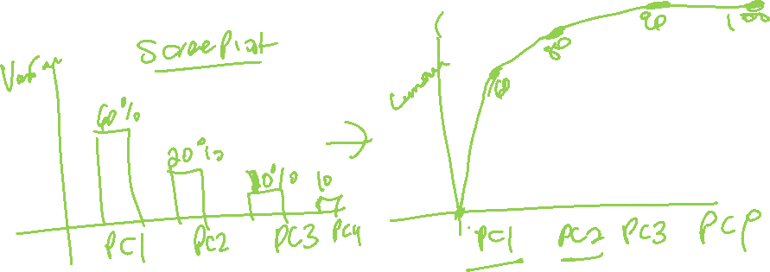

Slide 6
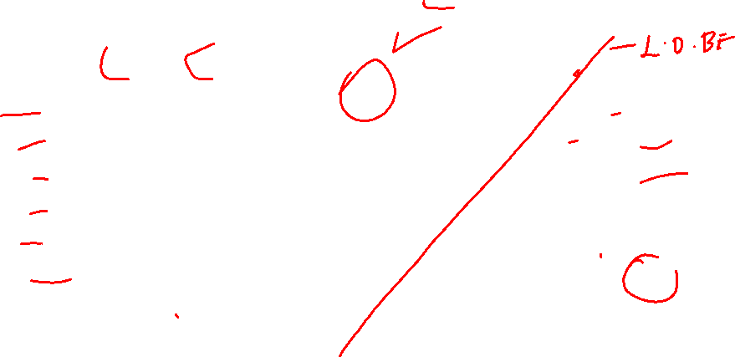
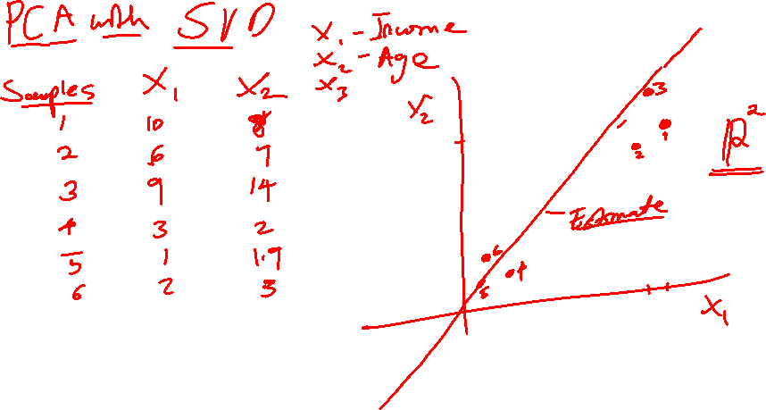

Slide 7
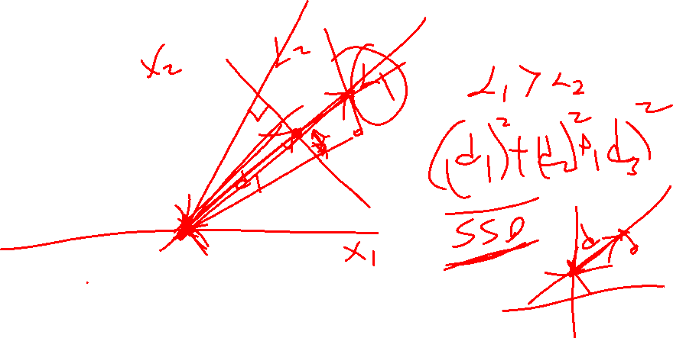

Slide 8
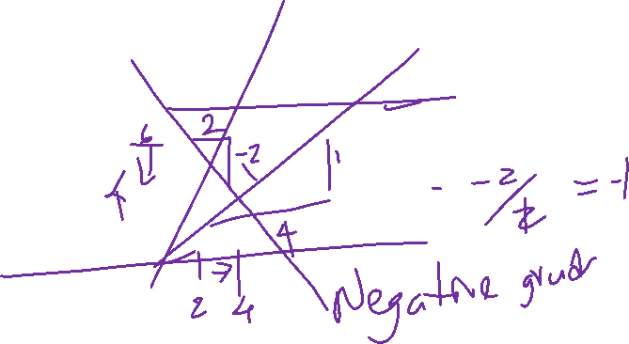

Slide 9
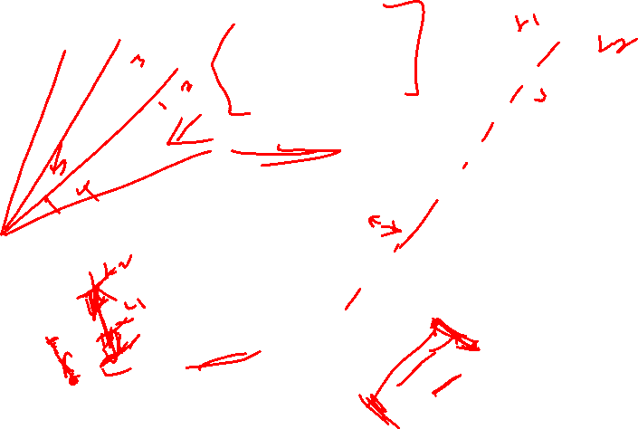
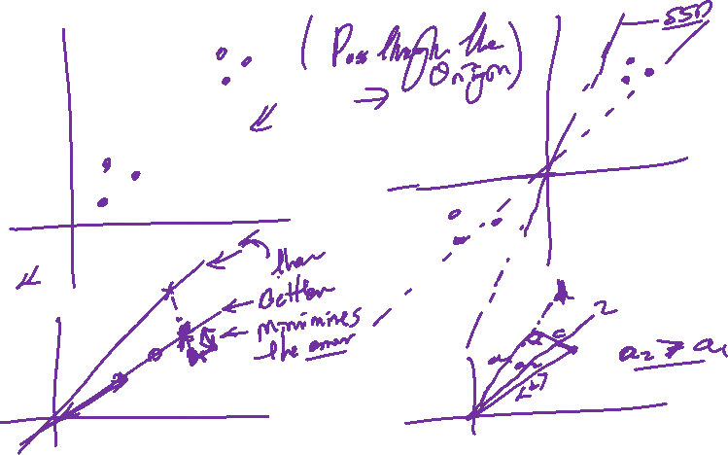

Slide 10
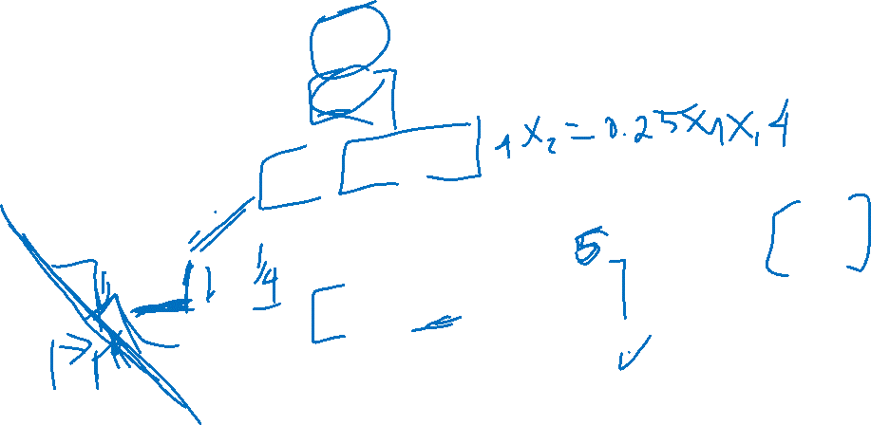
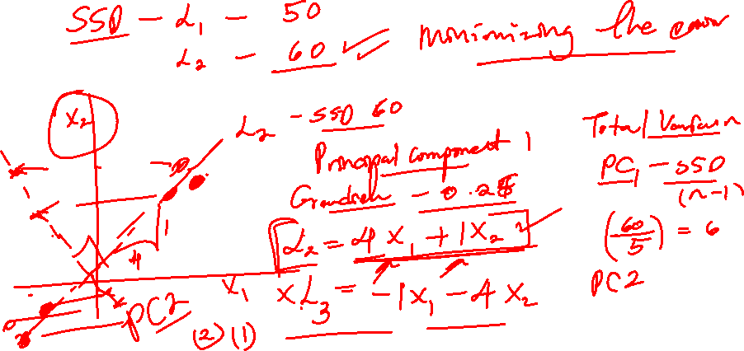

Slide 11
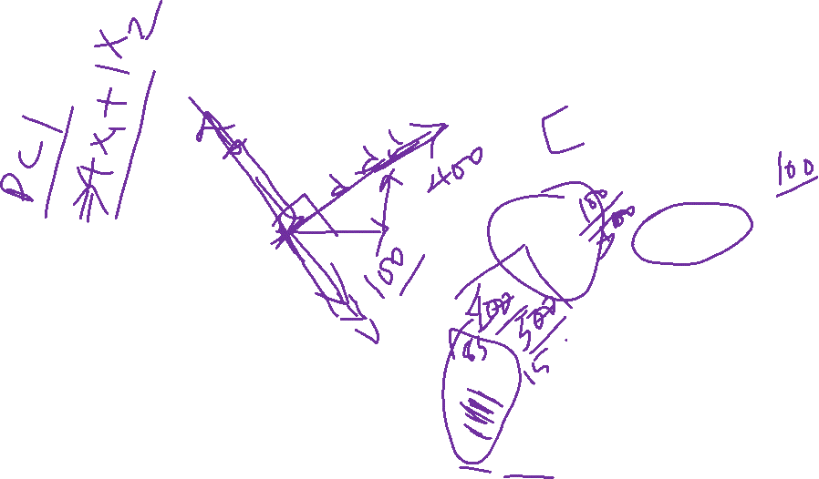
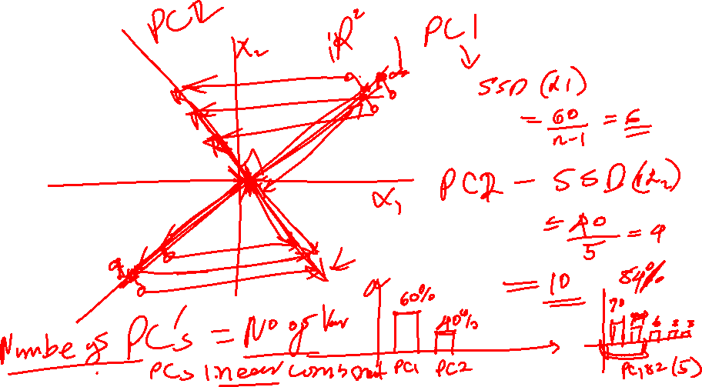

Slide 12
End…

